Slide 1

ADVANCE TRAUMA
Effects of Advanced Trauma Life Support® Training Compared to Standard Care on Adult Trauma Patient Outcomes: A Stepped-Wedge Cluster Randomised Trial
Protocol Summary and Progress

Slide 2
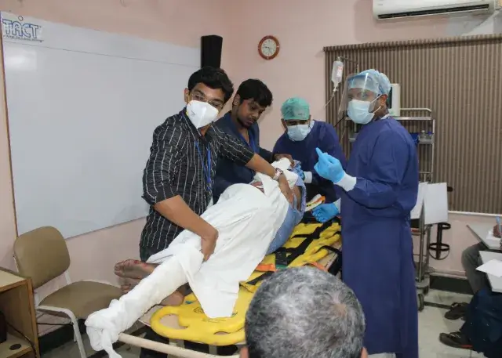

Slide 3


Slide 4
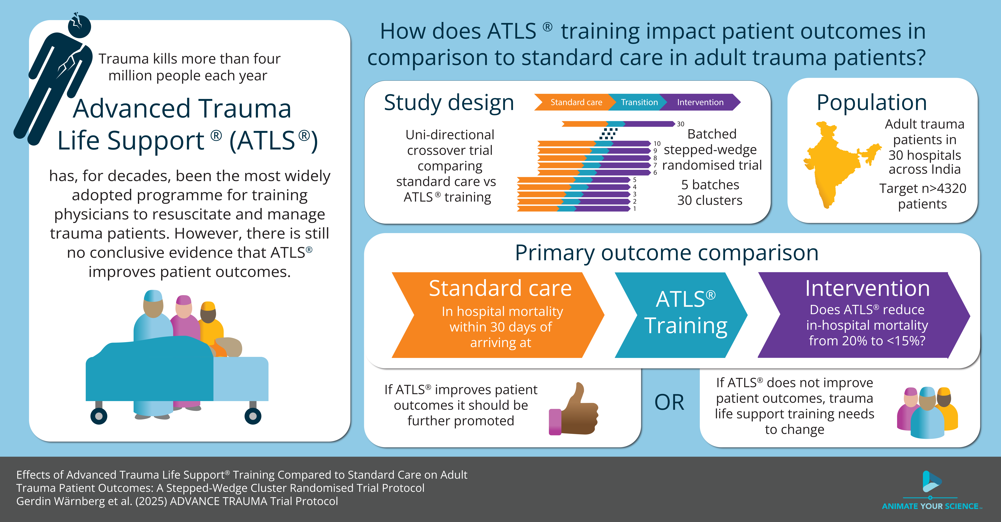

Slide 5
Trauma Scope of the problem
#1
cause of disease burden in people aged 10-49 years
4.3
million deaths globally
$4.2
trillions in the US alone

Slide 6
ATLS® Purpose and content
“emphasizes the rapid initial assessment and primary treatment of injured patients, starting at the time of injury and continuing through initial assessment, lifesaving intervention, reevaluation, stabilization, and, when needed, transfer to a trauma center”
> ATLS® Student Course Manual. 10th ed. 2018.

Slide 7
ATLS® Spread and dissemination
>1
million physicians trained
>80
countries worldwide
1978
first course

Slide 8
Aim To compare the effects of ATLS® training with standard care on outcomes in adult trauma patients

Slide 9
Primary outcome
30-day in-hospital mortality
Collected through medical records for patients admitted or discharged home
Collected through telephonic follow-up for patients transferred to another hospital

Slide 10
Secondary outcomes
All patients using main stepped-wedge design:
All cause and in-hospital mortality at 24 hours, 30 days and 90 days
Return to work, measured at 30 days and 90 days
Length of stay, in the ED, ICU and hospital
Random subset of patients using nested staircase design
Adherence to ATLS principles, collected through observations
Quality of life, measured using EQ5D5L at 30 days and 90 days
Disability, measured using WHODAS 2.0 at 30 days and 90 days

Slide 11
Main Design
Batched stepped-wedge cluster randomised trial:
30 hospitals
6 batches
5 sequences
13 months in trial

Slide 12
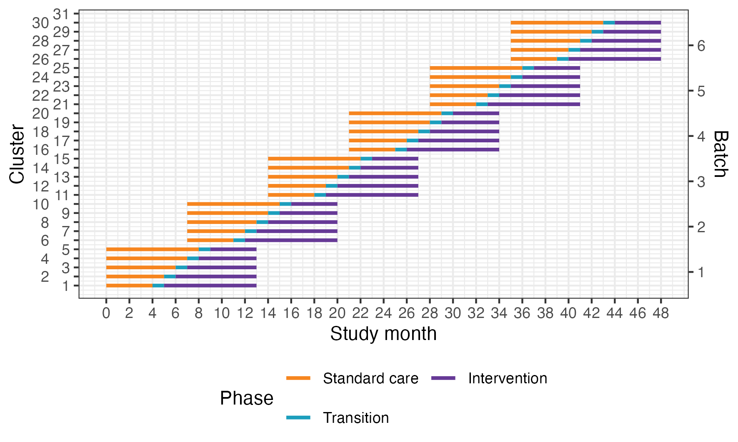
Main Design

Slide 13
Main Design
Nov | Dec | Jan | Feb | Mar | Apr | May | Jun | Jul | Aug | Sep | Oct | Nov
Observation | Train-ing | Intervention
Observation | Train-ing | Intervention
Observation | Train-ing | Intervention
Observation | Train-ing | Intervention
Observation | Train-ing | Intervention
Nov | Dec | Jan | Feb | Mar | Apr | May | Jun | Jul | Aug | Sep | Oct | Nov

Slide 14
Main Design
Nov | Dec | Jan | Feb | Mar | Apr | May | Jun | Jul | Aug | Sep | Oct | Nov
Observation | Train-ing | Intervention
Observation | Train-ing | Intervention
Observation | Train-ing | Intervention
Observation | Train-ing | Intervention
Observation | Train-ing | Intervention
Nov | Dec | Jan | Feb | Mar | Apr | May | Jun | Jul | Aug | Sep | Oct | Nov

Slide 15
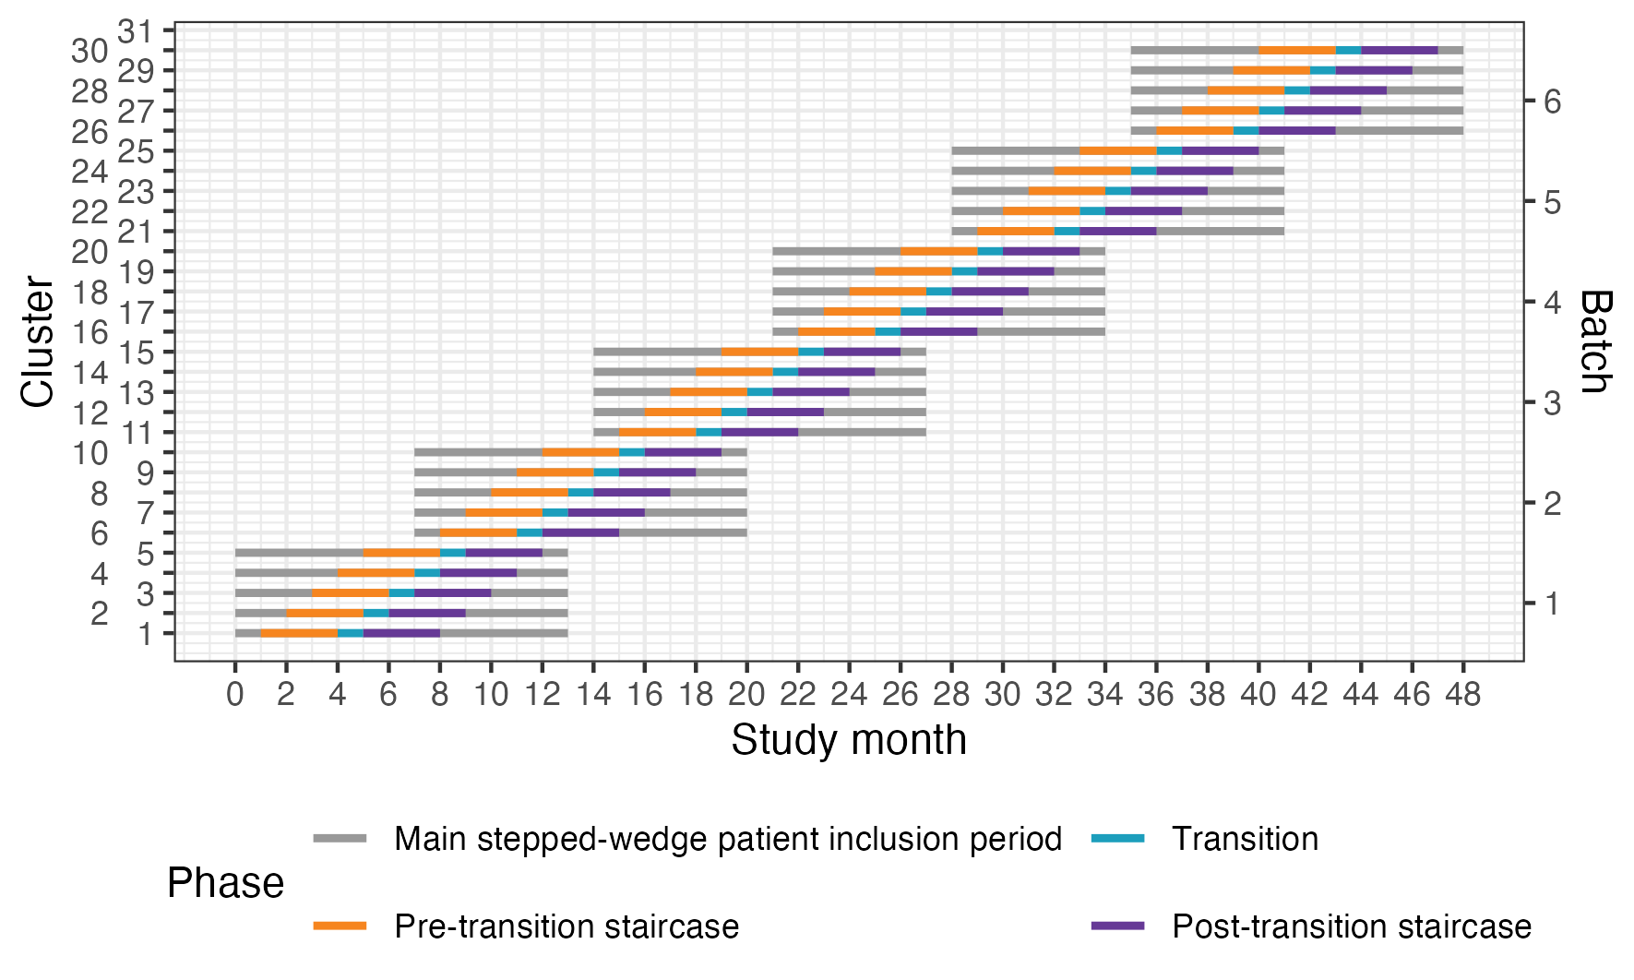
Nested staircase design

Slide 16
Eligibility criteria
Hospital
Secondary or tertiary hospitals in India that admit or refer/transfer for admission at least 400 patients with trauma per year
Cluster
One or more units of physicians providing initial trauma care in the participating hospitals
Patient
Adult trauma patients presenting to the emergency department of participating hospitals and who are admitted

Slide 17
Intervention and control
Intervention
2.5 day ATLS training course
Accredited ATLS training facility in India
1-2 units per hospital
Control
Standard care, meaning care as usual
No modifications

Slide 18
Intervention implementation
We can train an average of 10 physicians per hospital
Important
Train those who initially resuscitates trauma patients
Maximise the number of trained physicians in the emergency department on a given day
Train as many as possible in the same unit
The timing of the training will be randomised
The first hospital will undergo training four months after the trial starts
Hospitals will be informed about their sequence one month in advance

Slide 19


Intervention implementation
 | Unit 1/Monday & Thursday | Unit 2/Tuesday & Friday | Unit 3/Wednesday & Saturday
Resident 1
Resident 2
Resident 3
Resident 4
 | Unit 1/Monday & Thursday | Unit 2/Tuesday & Friday | Unit 3/Wednesday & Saturday
Resident 1
Resident 2
Resident 3
Resident 4

Slide 20
Intervention implementation
 | Unit 1/Monday & Thursday | Unit 2/Tuesday & Friday | Unit 3/Wednesday & Saturday
Resident 1
Resident 2
Resident 3
Resident 4
 | Unit 1/Monday & Thursday | Unit 2/Tuesday & Friday | Unit 3/Wednesday & Saturday
Resident 1
Resident 2
Resident 3
Resident 4

Slide 21
Intervention implementation
 | Unit 1/Monday & Thursday | Unit 2/Tuesday & Friday | Unit 3/Wednesday & Saturday
Resident 1
Resident 2
Resident 3
Resident 4
 | Unit 1/Monday & Thursday | Unit 2/Tuesday & Friday | Unit 3/Wednesday & Saturday
Resident 1
Resident 2
Resident 3
Resident 4

Slide 22
Sample size
We count on each cluster (often 1 cluster = 1 unit) to enrol at least 12 patients per month
We need at least 4320 patients to be able to detect a reduction in mortality from 20 to 15%

Slide 23
Consent
Opt-out
Majority, including primary outcome
All variables considered routinely collected and adherence data
Opt-in
Less common
Variables that are not routinely collected, including follow-up
Waiver
For patients who are unconscious and are without a legally authorized representative

Slide 24
Data collection
One Clinical Research Coordinator (CRC) per participating hospital
Enrols patients admitted under the participating unit(s)
Most data are extracted from medical records
Some outcomes will be collected through observation or telephone follow-up

Slide 25
Data collection
Adherence to ATLS principles will be collected through observation
14 step checklist covering assessments and interventions that are part of the primary survey
Will require training of CRCs to recognize these assessments and interventions
Observe ATLS course or training by the trial team
Collection of adherence data from 10 patients under supervision of ATLS-trained senior clinician at each study site

Slide 26
Study timeline 2025
8/11
Investigator meeting
10/11-14/11
CRC training including ATLS-adherence
17-21/11
Pilot data collection
24-28/11
Mock ATLS adherence data collection
1/12
Batch 2 trial start

Slide 27
Study timeline 2026-2027
May
3rd site undergoes ATLS training
1st site undergoes ATLS training
April
2nd site undergoes ATLS training
June
4th site undergoes ATLS training
July
5th site undergoes ATLS training
January 2027
End of study batch 2
March
End of study batch 1

Slide 28
Safety reporting
We collect safety events indicative of pulmonary, renal, septic or bleeding complications:
Prolonged mechanical ventilation (> 7 days)
Initiation of renal replacement therapy
Prolonged (> 2 days) or renewed (restart after at least 2 days without) use of vasopressors
Any other event resulting in prolonged hospitalisation, death, or other meaningful harm as determined by the investigator

Slide 29
Safety reporting
Safety events will be captured by Clinical Research Coordinators
Require review by investigator to assess if the event is potentially related to the intervention
This assessment is recorded in the CRF
Events assessed to be potentially related to the intervention are reported to the Trial Management Group
Decision by the Trial Steering and Data Monitoring Committee

Slide 30
Progress

Slide 31
Progress
 | Cluster 1 (n = 75) |  | Cluster 2 (n = 141) | Cluster 3 (n = 459) | Cluster 4 (n = 57) | Cluster 5 (n = 60) | Overall (n = 792)
Total injuries, no. (pp) | 147 (2) |  | 388 (2.8) | 1793 (3.9) | 93 (1.6) | 55 (0.9) | 2476
Age in years, median (IQR) | 35.5 (24-47.5) |  | 37 (26-55) | 39 (26-55) | 34 (25-42) | 40 (28-51) | 36.4
Missing no. | 1 |  | 6 | 0 | 0 | 2 | 6
Female sex, no. (%) | 8 (11) |  | 26 (19) | 83 (18) | 12 (21) | 5 (9) | 111 (17)
Missing no. | 1 |  | 6 | 0 | 0 | 2 | 6
Mechanism of injury, no. (%)
Transport | 43 (57) |  | 88 (64) | 317 (64) | 37 (65) | 31 (52) | 418 (62)
Fall | 18 (29) |  | 28 (27) | 106 (27) | 06 (11) | 06 (10) | 164 (24)
Assault | 09 (15) |  | 4 (4) | 10 (3) | 08 (14) | 13 (22) | 44 (7)
Self-harm | NA |  | 3 (3) | 1 (0) | 1 (2) | NA | 5 (1)
Other | NA |  | 2 (2) | 24 (6) | 5 (9) | 2 (3) | 33 (5)
Missing | NA |  | NA | NA | NA | 8 (13) | 8 (1)
Transfer, no. (%) | 10 (16) |  | 31 (30) | 282 (72) | 6 (11) | 37 (61) | 366 (54)
Hospital disposition, no. (%)
Alive | 48 (77) | 95 (92) |  | 264 (68) | 54 (95) | 46 (77) | 507 (75)
Dead | 10 (16) | 5 (5) |  | 71 (18) | 3 (5) | 1 (2) | 90 (13)
Transfer | NA | NA |  | 2 (1) | NA | NA | 2 (0)
Missing | 4 (6) | 3 (3) |  | 53 (14) | 0 | 13 | 73 (11)

Slide 32
ADVANCE TRAUMA
Effects of Advanced Trauma Life Support® Training Compared to Standard Care on Adult Trauma Patient Outcomes: A Stepped-Wedge Cluster Randomised Trial
Protocol Summary and Progress

